Slide 1

CISC7201
Data Analysis
Financial Dataset – “Fraud”
JIANG XINYANG (Lily)
M-B9-5533-1

Slide 2
01
Introduction
Data
CONTENT
02
(Collect, Clean, Process, "Finding”
Analyze, Visualize, Forecast)
03
Conclusion

Slide 3
01
( p′︵‵。)
Introduction

Slide 4
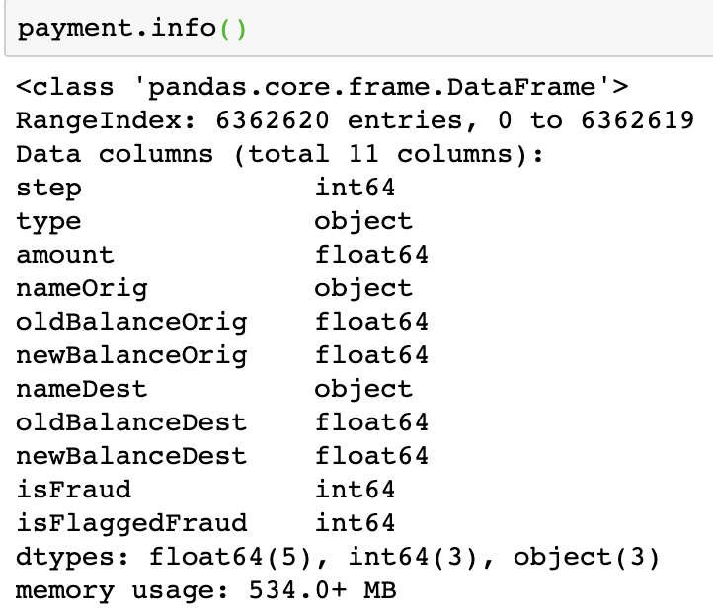

Financial Dataset - Fraud Detection

Slide 5
New Libraries
Seaborn
Matplotlib
Statistics
Scikit-learn
Calculation
(mean, median...)
Transfer Data Type
Prediction
Visualization (graph)
Visualization (graph)
New tools: Pydotplot, Graphviz

Slide 6
02
_(:з」∠)_
Data
(Collect, Clean, Process, “Finding”,
Analyze, Visualize, Forecast)

Slide 7
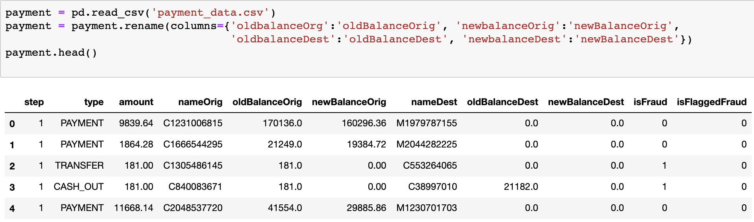
Column Name | Data Type | Description
step | int64 | Maps a unit of time in the real world. (1 step is 1 hour of time.)
type | object | types of transactions
amount | float64 | amount of the transaction in local currency
nameOrig | object | customer name who started the transaction
oldbalanceOrg | float64 | initial balance before the transaction
newbalanceOrig | float64 | customer's balance after the transaction.
nameDest | object | recipient name of the transaction.
oldbalanceDest | float64 | initial recipient balance before the transaction.
newbalanceDest | float64 | recipient's balance after the transaction.
isFraud | int64 | fraudulent transaction (1) and non fraudulent (0)
isFlaggedFraud | int64 | flags illegal attempts to transfer more than 200,000 in a single transaction.

Slide 8

More analysis in my
report and “.ipynb”
Data

Slide 9
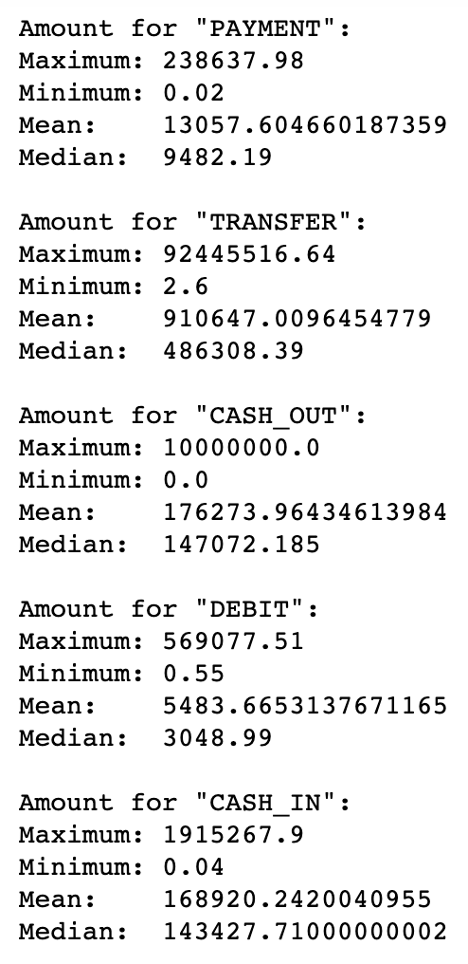
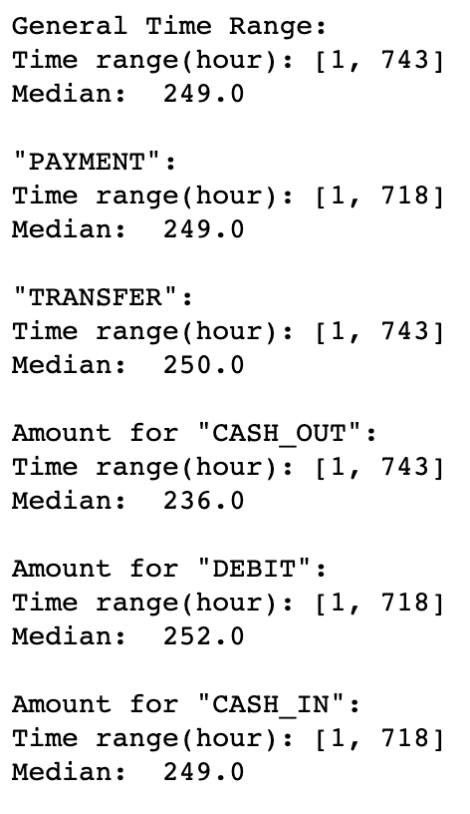
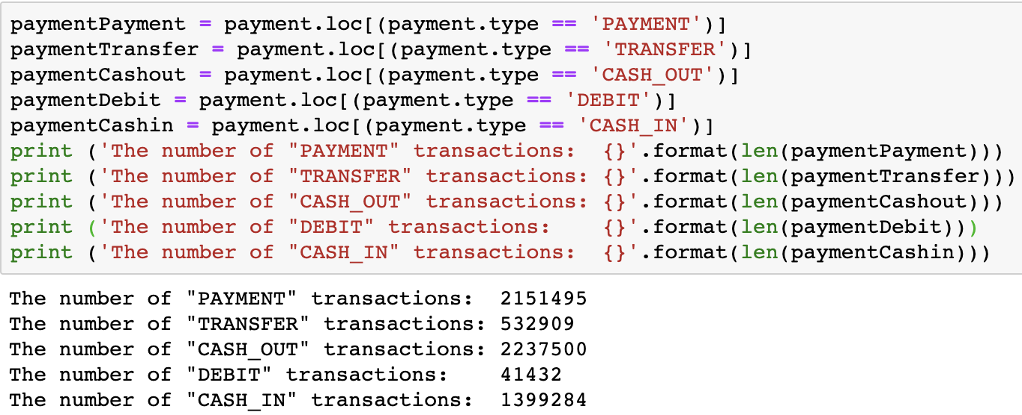
Payment:
2,151,495 (33.81%)
Transfer:
532,909 (8.38%)
Cash-Out:
2,237,500 (35.17%)
Amount
Debit:
41,432 (0.65%)
Time (step)
Type
Cash-In:
1,399,284 (21.99%)
Fraud: 8213 (0.13%)

Slide 10
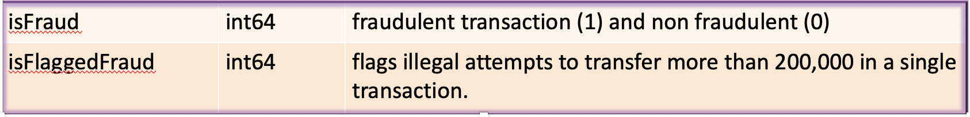
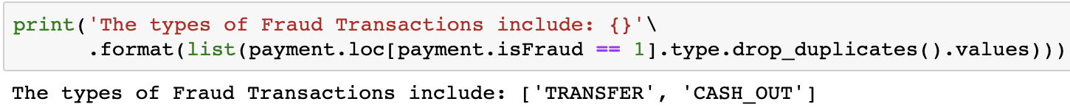
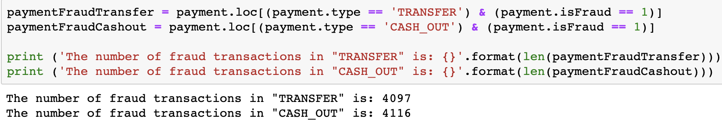
Findings:
Fraud only happen in “Transfer” & “Cash-Out”.
Fraud: transfer → cash-out to empty the funds.
Every account set as “Fraud” never has a second used.
“isFlaggedFraud” is not accurately set.
No merchant appears in Fraudulent Transactions.
Some data might be missed because of transaction halted.

Slide 11
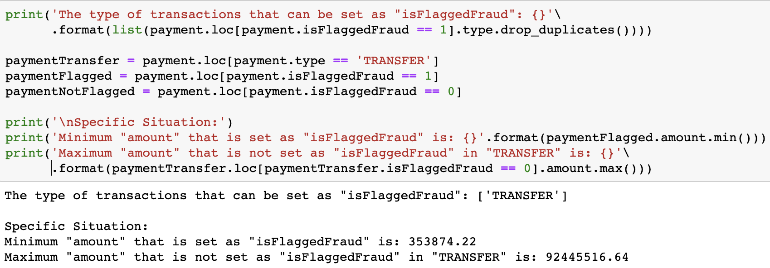
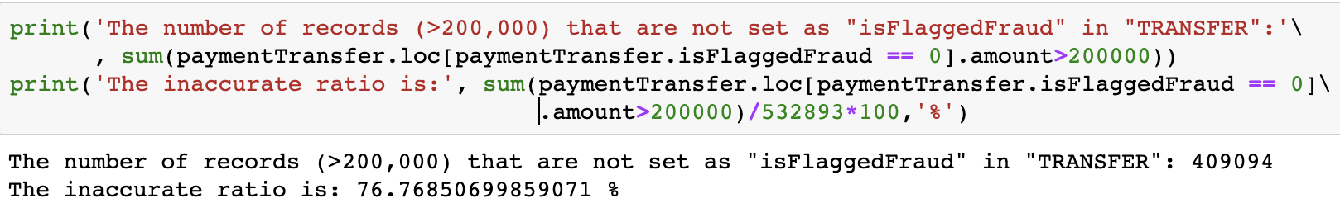
“isFlaggedFraud” is not accurately set.
Range is not accurate.
High inaccurate rate.
No determinants after analysis → USELESS
More analysis in my report and “.ipynb”

Slide 12
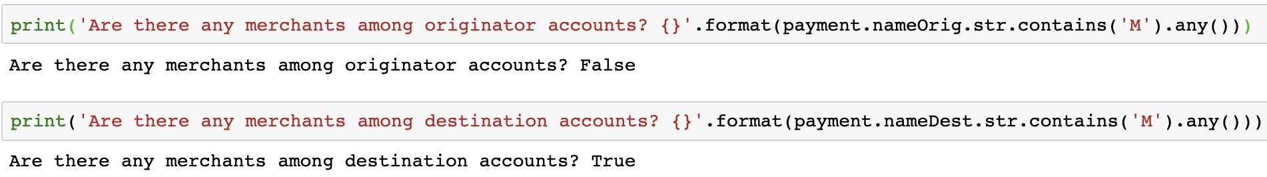
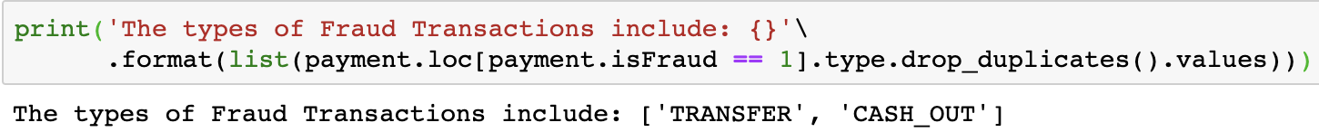
“name”
“Cxxx”(customer)
“Mxxx”(merchant)
nameOrig
nameDest
∴ Merchants not appear in Fraudulent Transactions.
customer name who started the transaction
recipient name of the transaction.
More analysis in my report and “.ipynb”

Slide 13
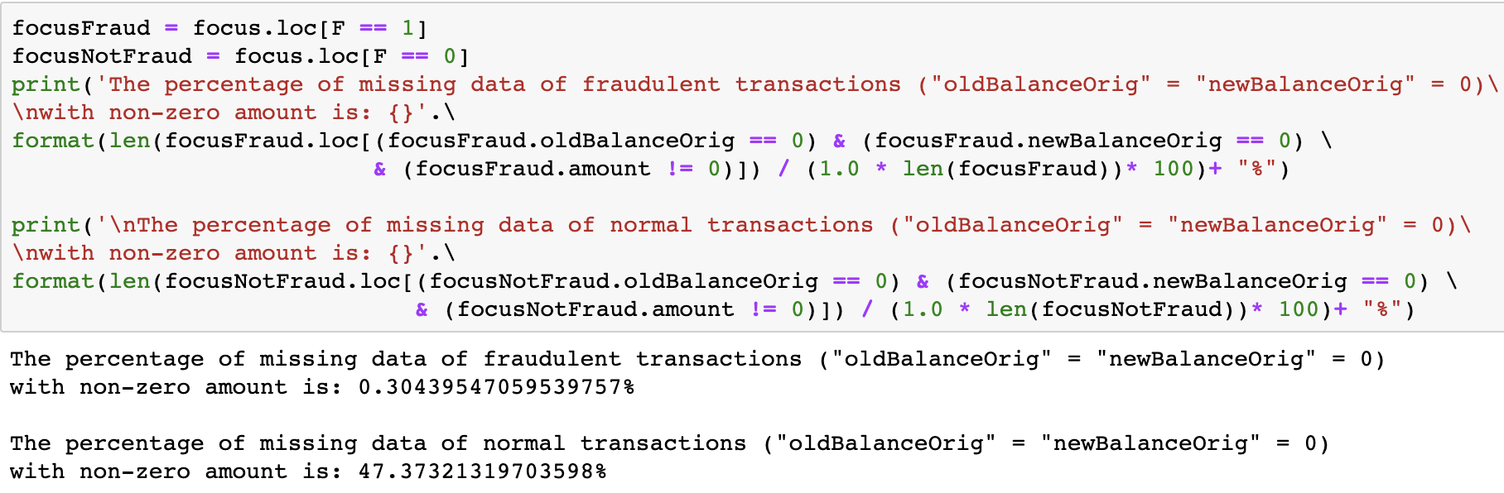
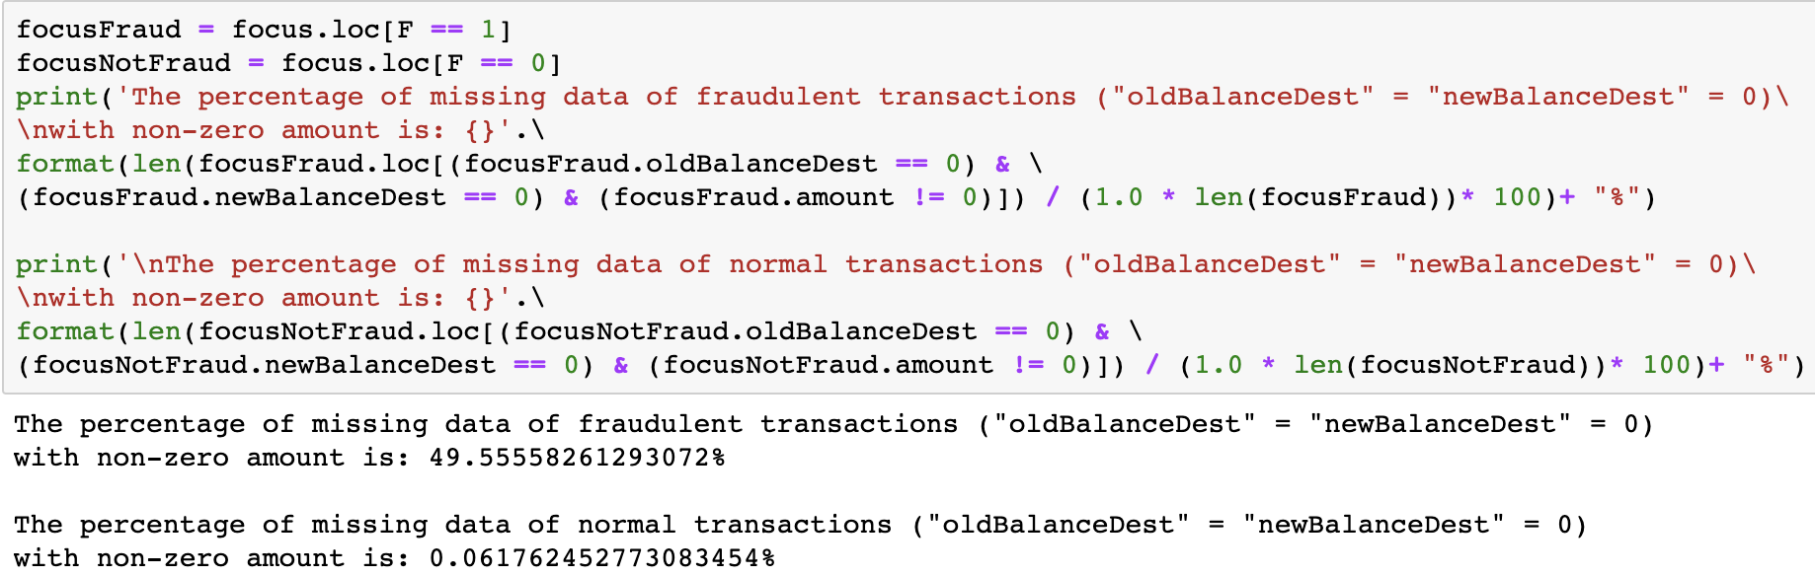
Some data might be missed because of transaction stopped.
Missing data (%) | Originator account == 0 | Destination Account == 0
Normal Transaction | 47.37% | 0.06%
Fraudulent Transaction | 0.30% | 49.56%
However, it is one way to see whether the transaction
is fraudulent or not.
More analysis in my report and “.ipynb”

Slide 14
More analysis in my report and “.ipynb”

Slide 15
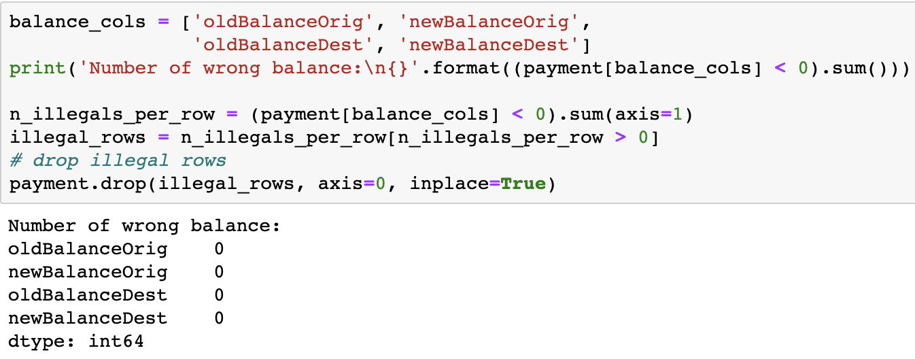
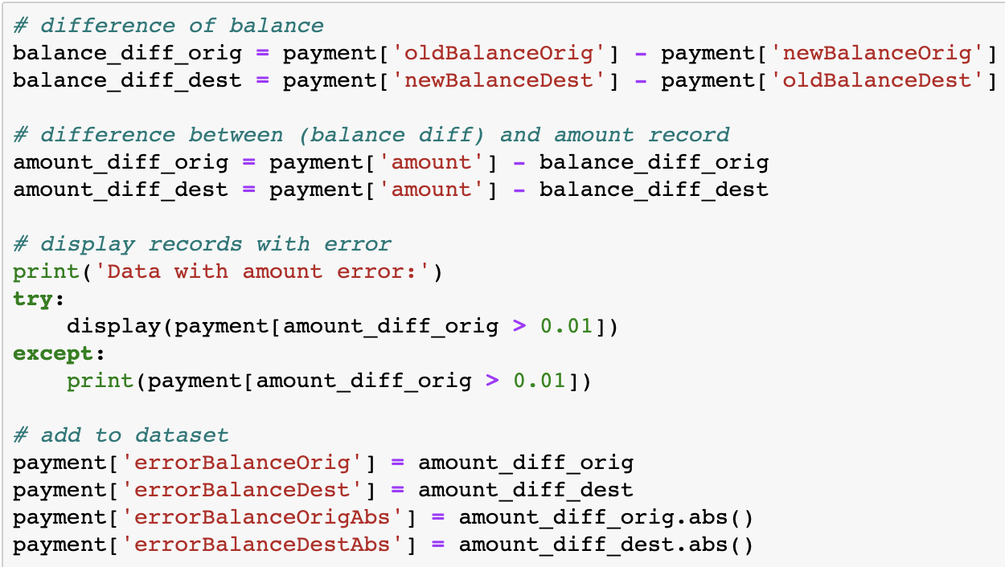
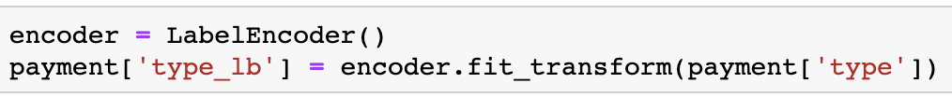
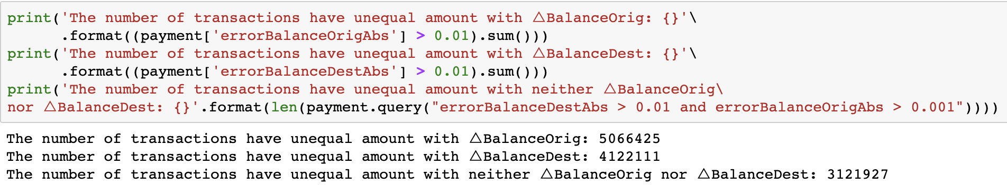
Data Cleaning and Processing:
→ 0 NA record.
→ 0 illegal record.
Filter “TRANSFER” and “CASH_OUT” copy as “focus” to
make some part of analysis easier.
Change data type of “type”. (using new library)
Drop useless columns.
Add new features “errorBalanceOrig”, “errorBalanceDest” and the corresponding “Abs” records.

Slide 16
Bar chart
Swarm Plot
Strip Plot
Heat Map
More analysis in my report and “.ipynb”

Slide 17
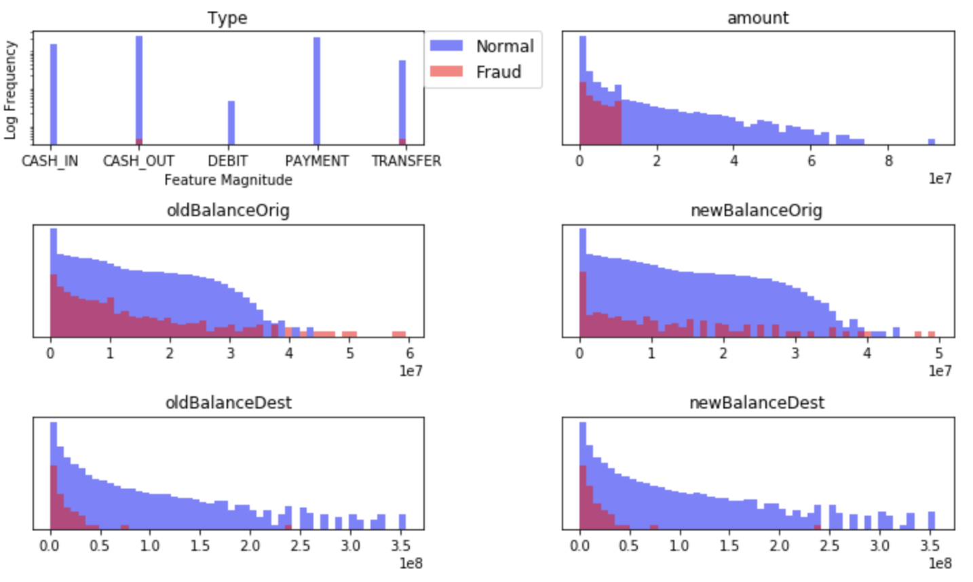
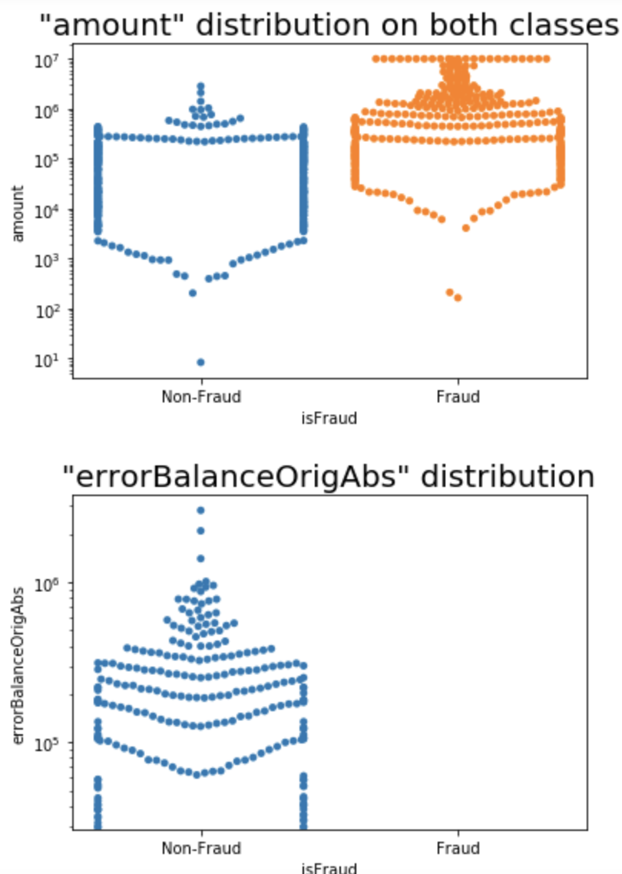
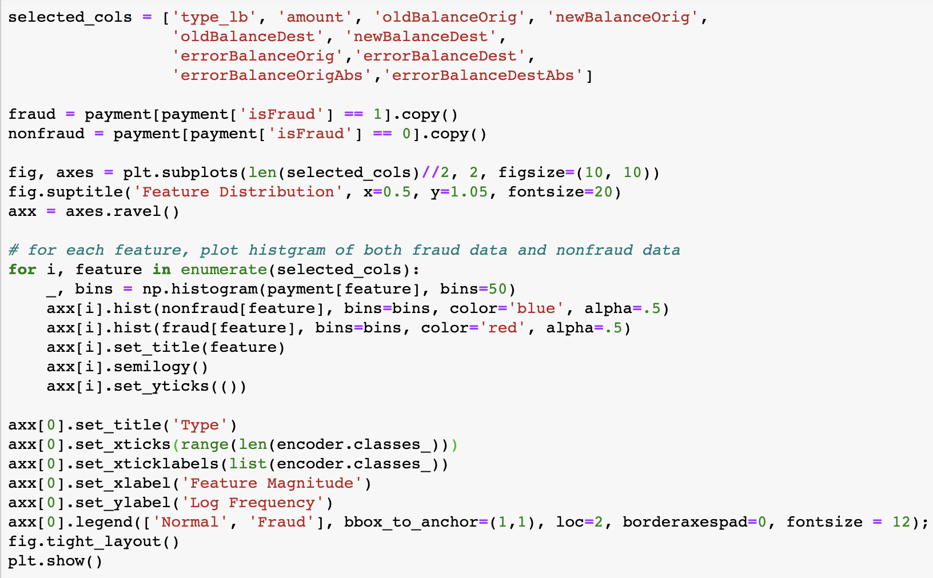
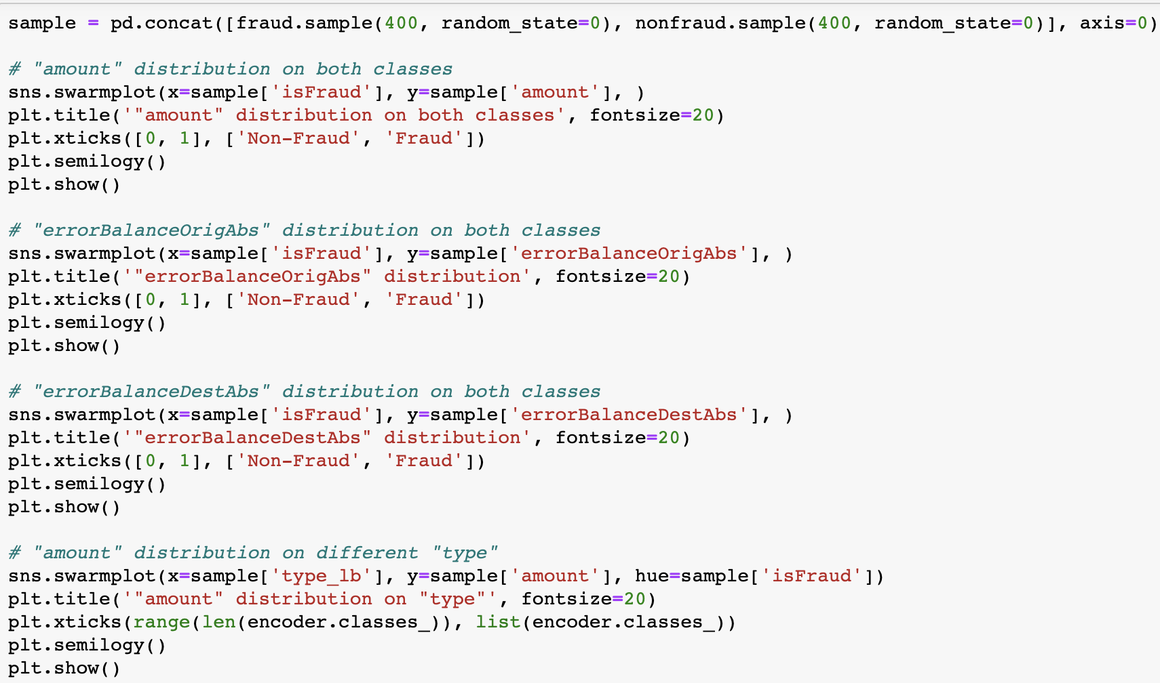
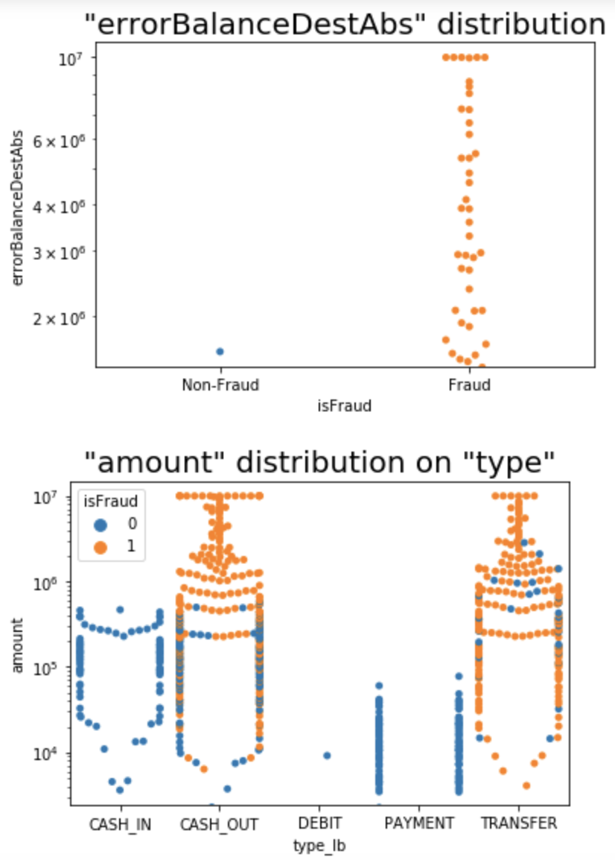
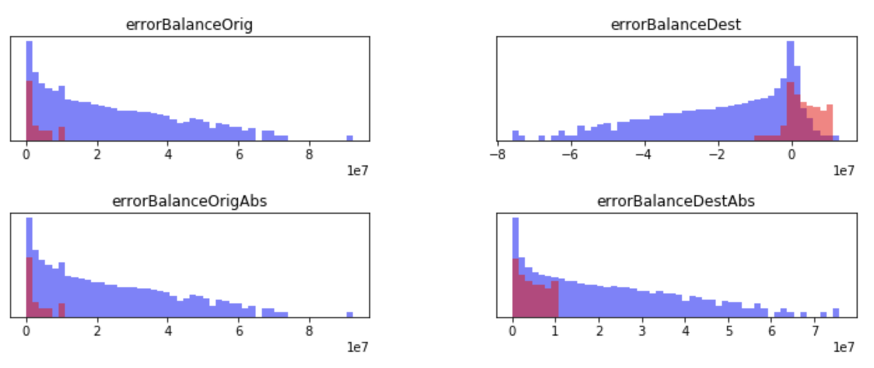

Slide 18
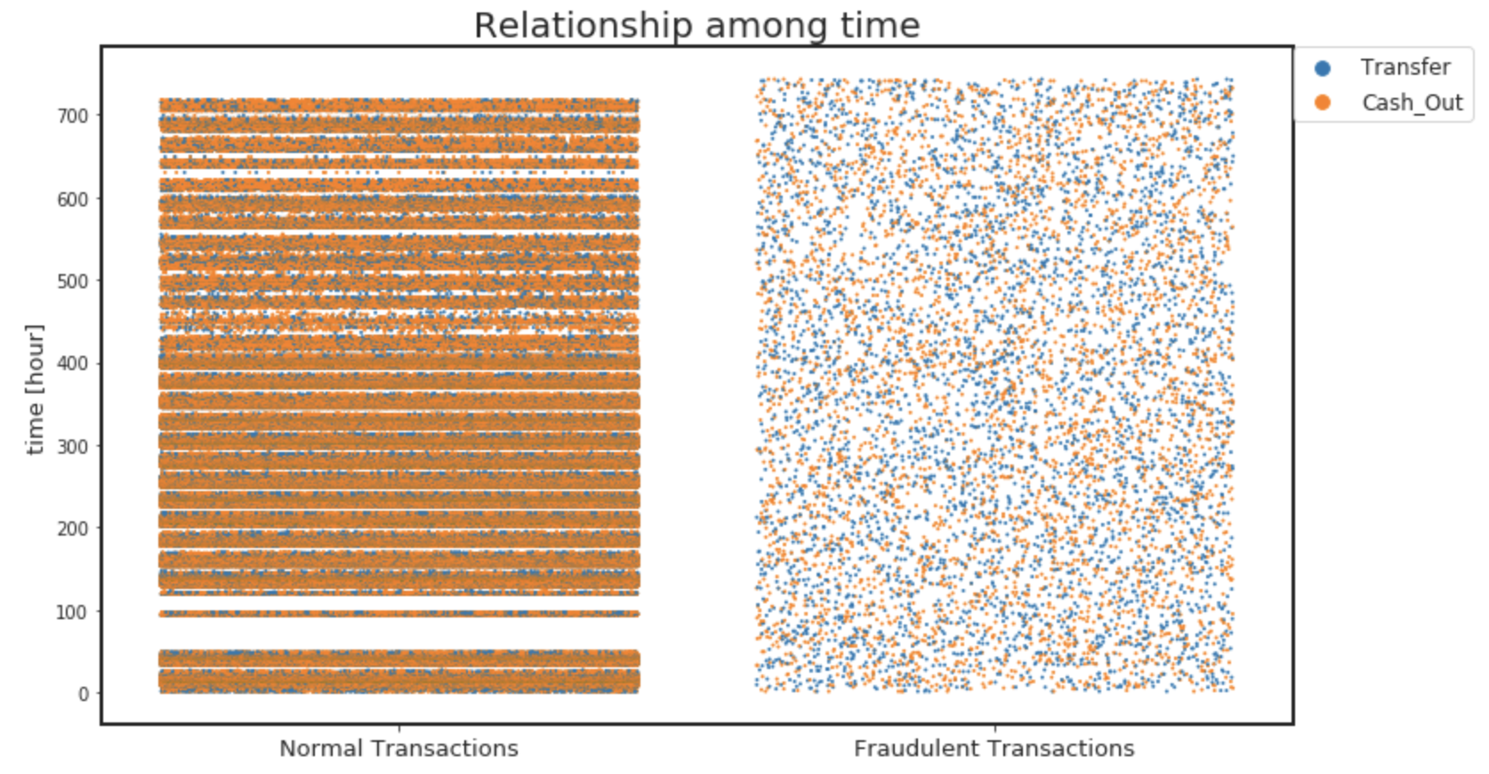
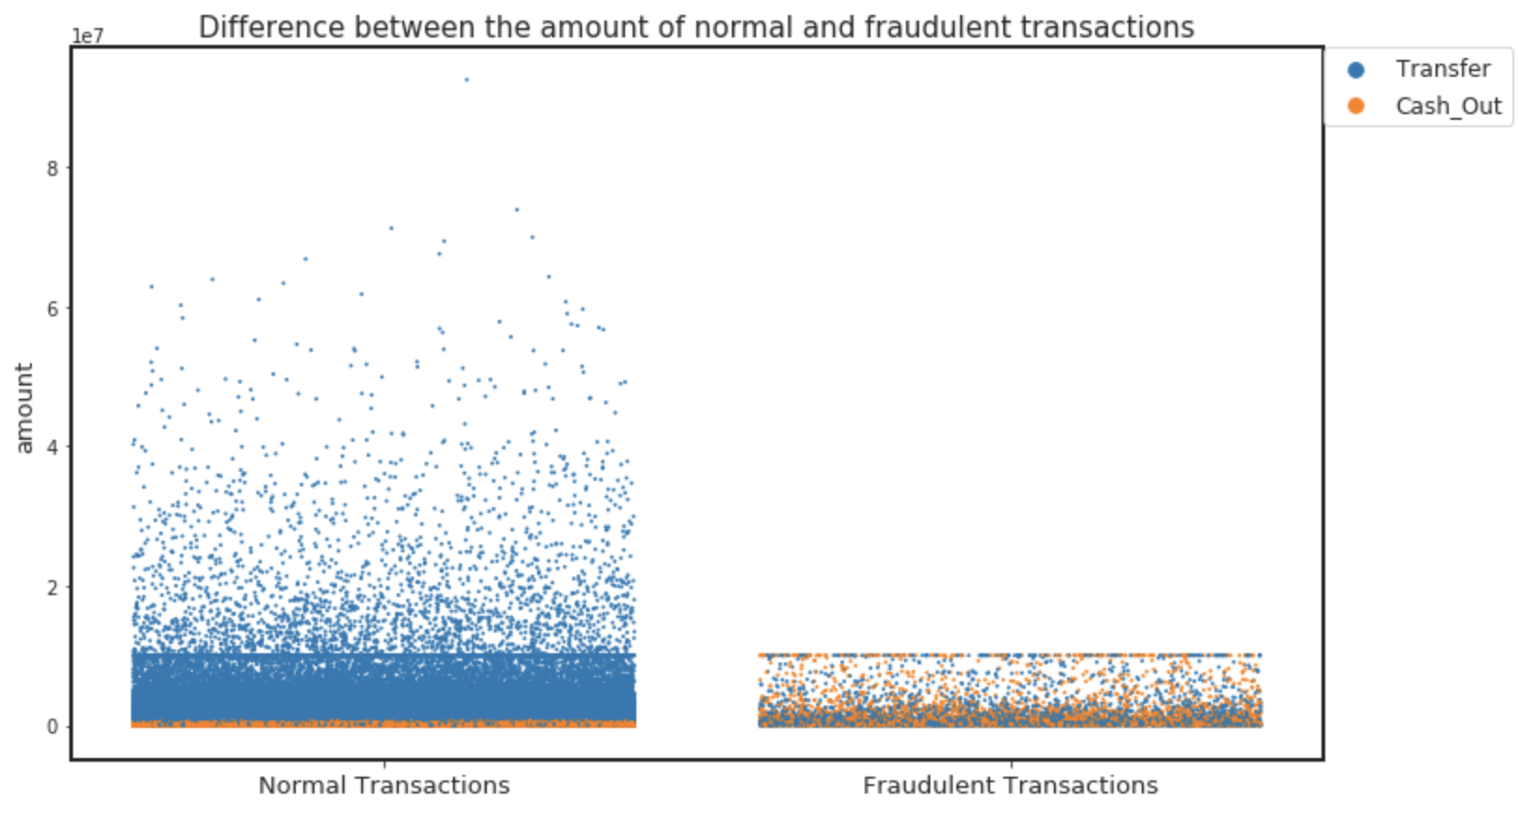
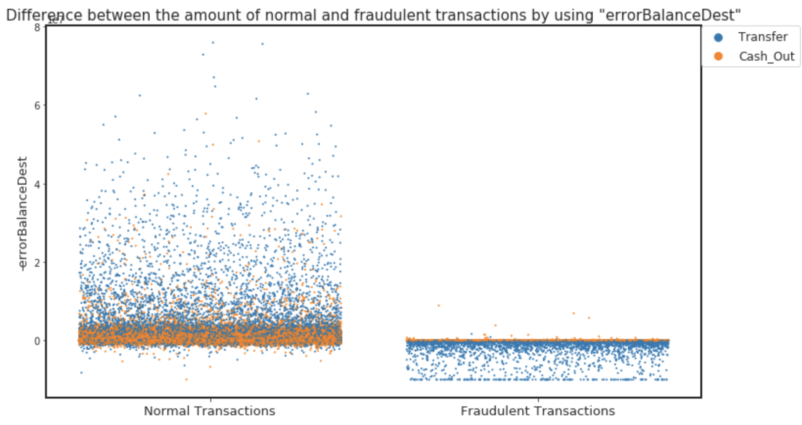
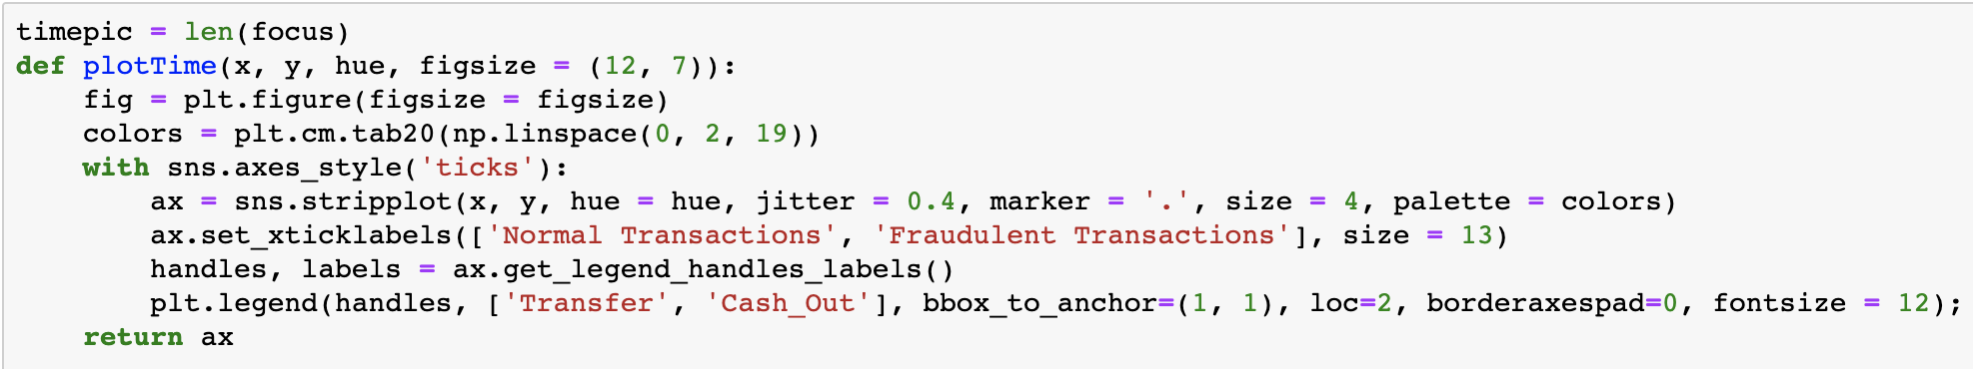
Only focus on “TRANSFER” and “CASH_OUT”

Slide 19
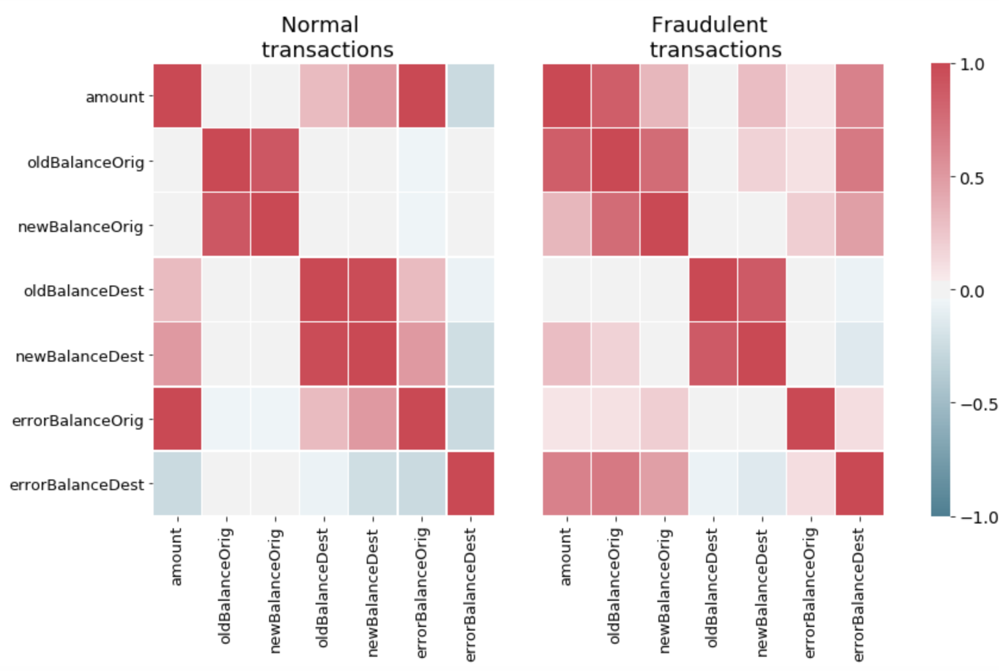
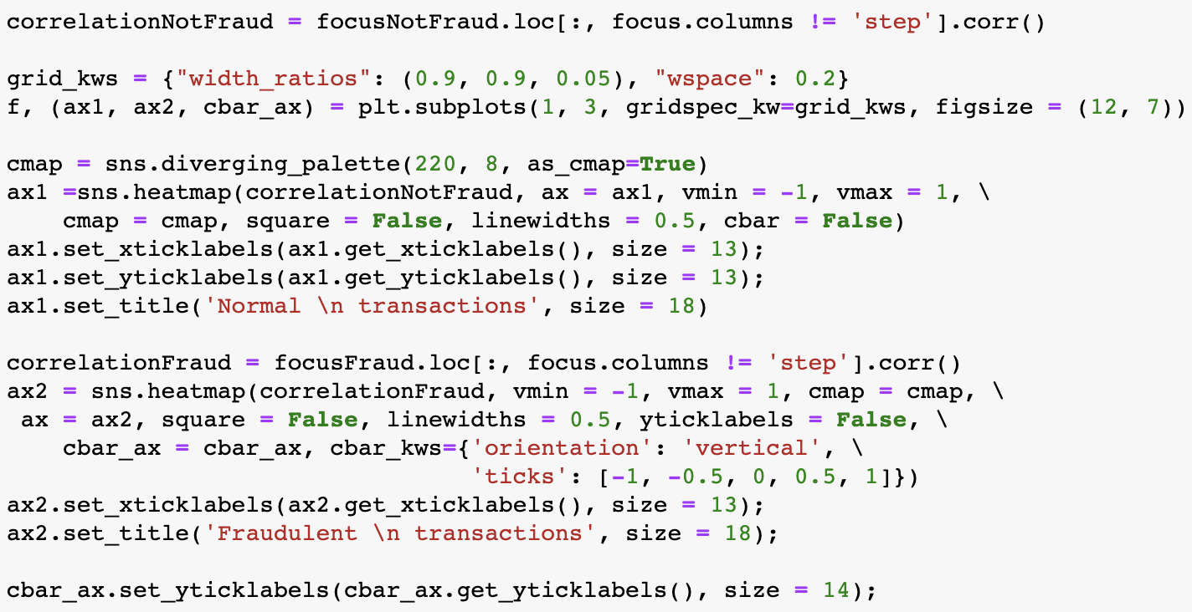
Only focus on “TRANSFER” and “CASH_OUT”: Heat Map → correlation

Slide 20

More analysis in my report and “.ipynb”

Slide 21
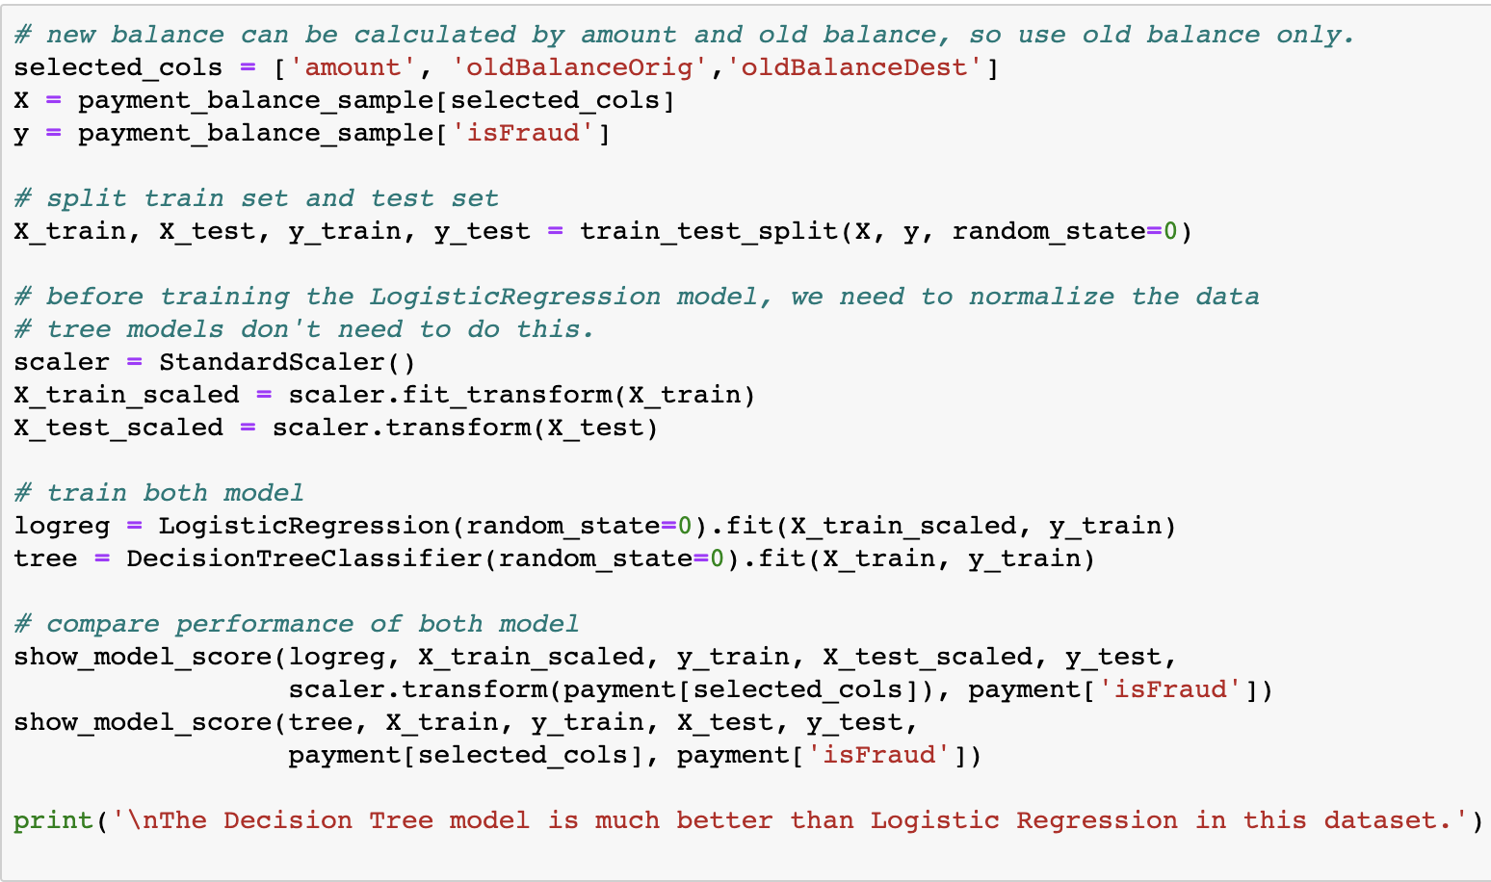
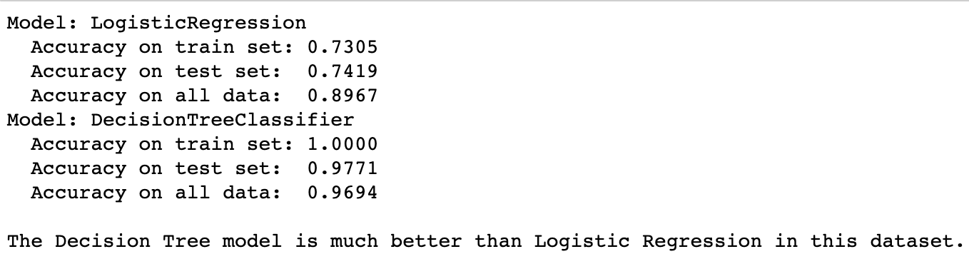
Accuracy > 99%

Slide 22
03
(＾－＾)V
Conclusion

Slide 23
Conclusion
New features“errorBalanceDest”and “errorBalanceOrig”are very useful in this analysis.
Fraud is more likely to happen when amount is unequal to the difference between old and new BalanceDest.(Receviers) When the amount is not equal to the difference between old and new BalanceOrig (starters), it is more likely a normal transaction.)
I think this dataset cannot represent all the situation. We cannot think that the fraud only happen in "CASH_OUT" and "TRANSFER". Now we are using this dataset to analysis and do training, so if a fraud happen in the other kind of transaction, this model may not predict it correctly.
There might be data missing, this problem should be solved in the future.

Slide 24
CISC7201
THE END!

